Slide 1
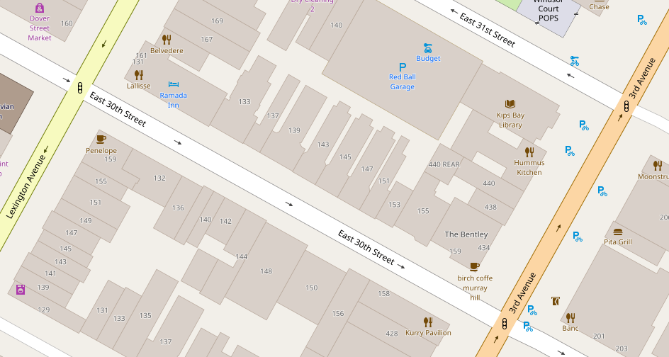
begin node
length
end node

